Slide 1
Detecting Sleep Apnea – Projet Period 2
Resampling Annotations
Some results after resampling

Slide 2
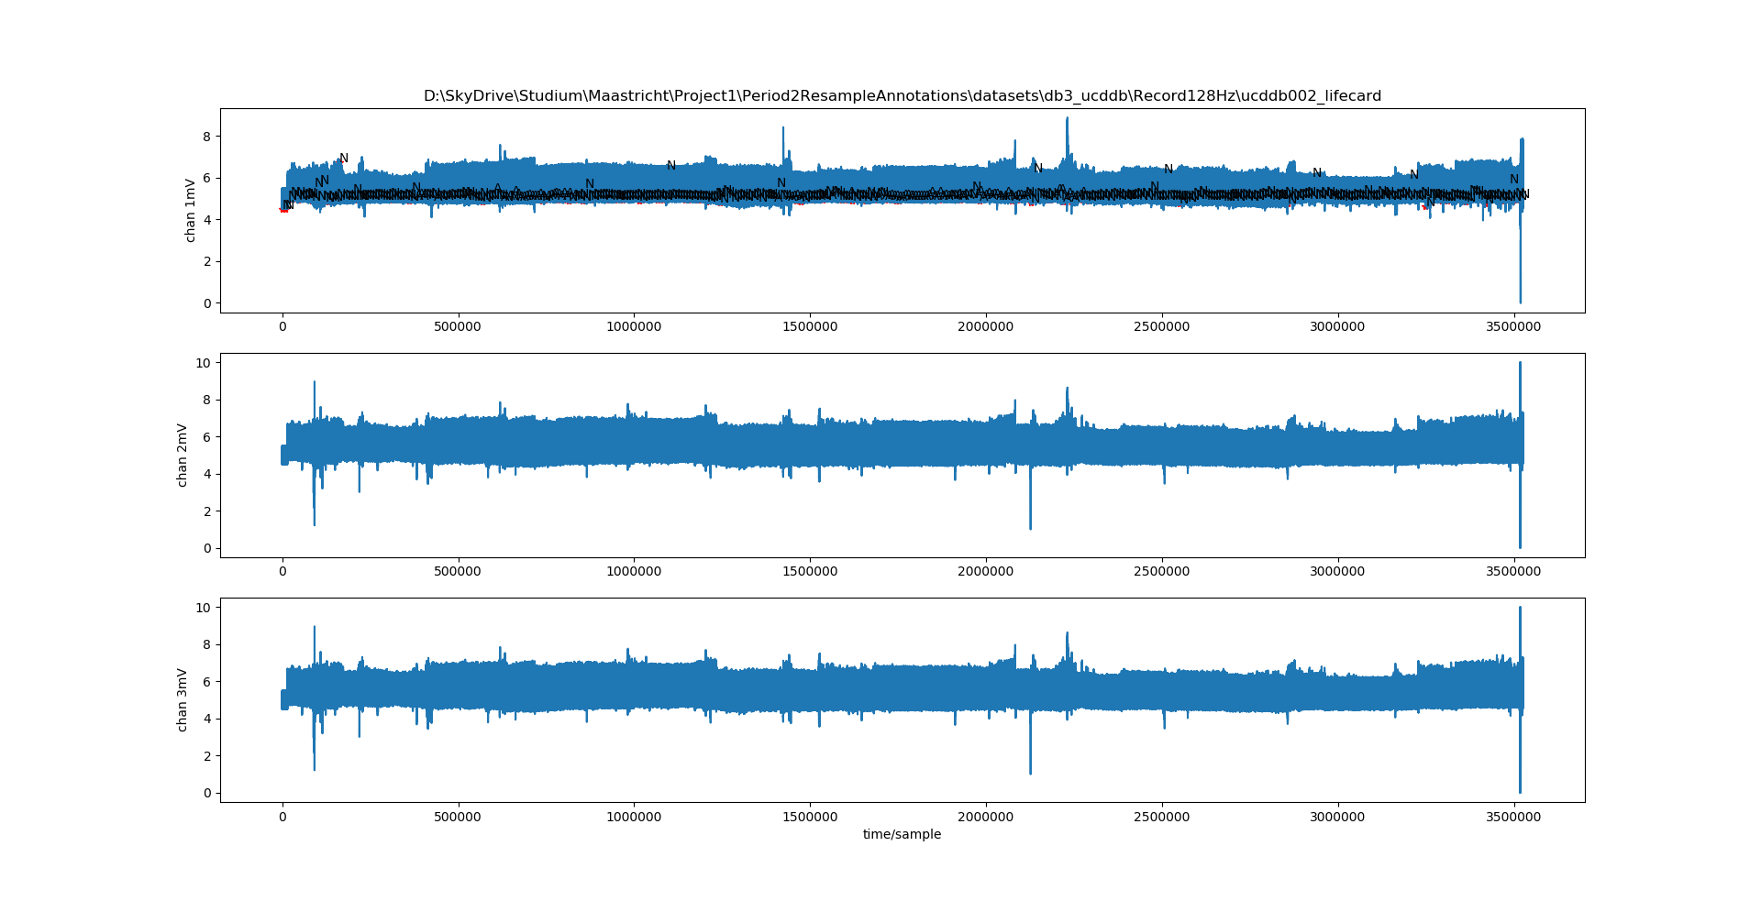
Database 3: ucddb002 128Hz original (+ resampled ann.)

Slide 3
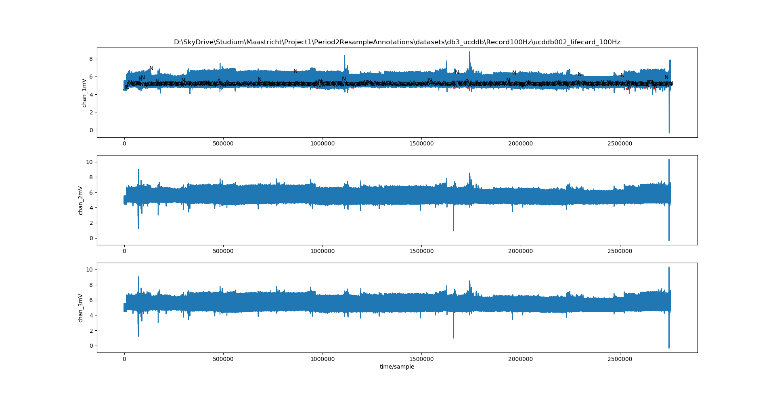
Database 3: ucddb002 100Hz (+ resampled ann.)

Slide 4
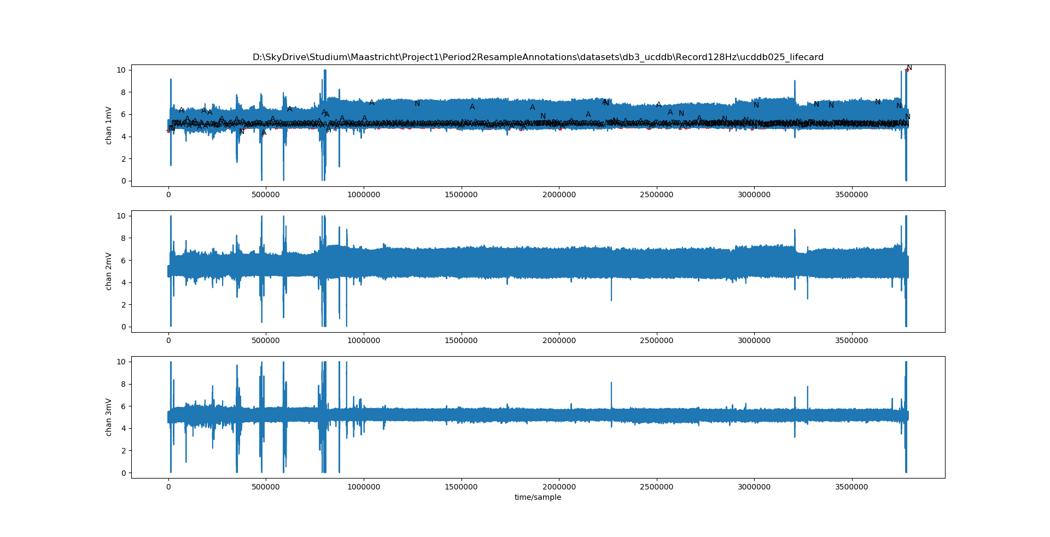
Database 3: ucddb025 128Hz original (+ resampled ann.)

Slide 5
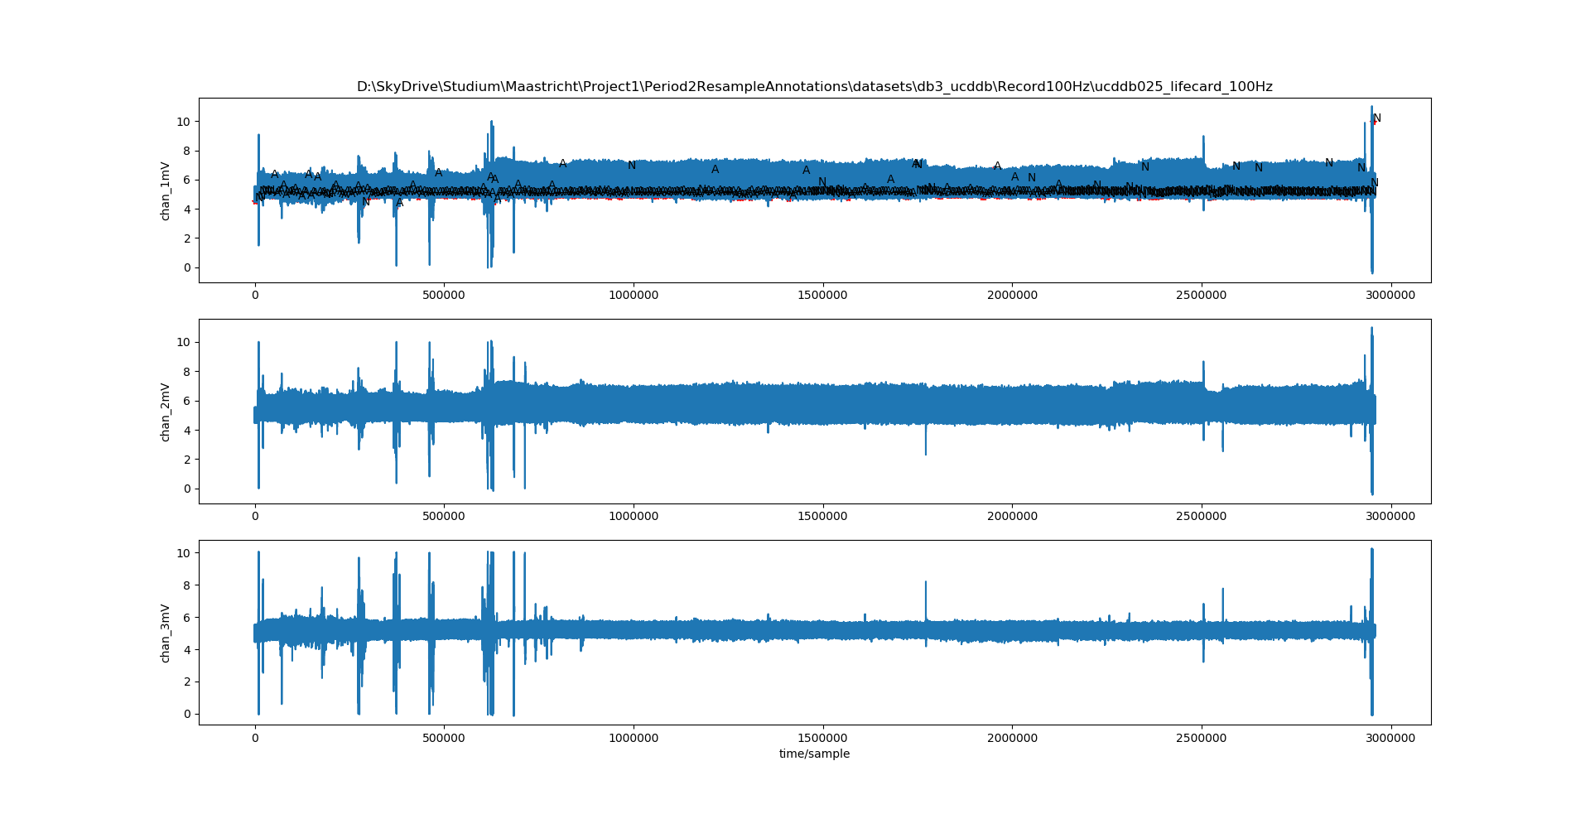
Database 3: ucddb025 100Hz (+ resampled ann.)

Slide 6
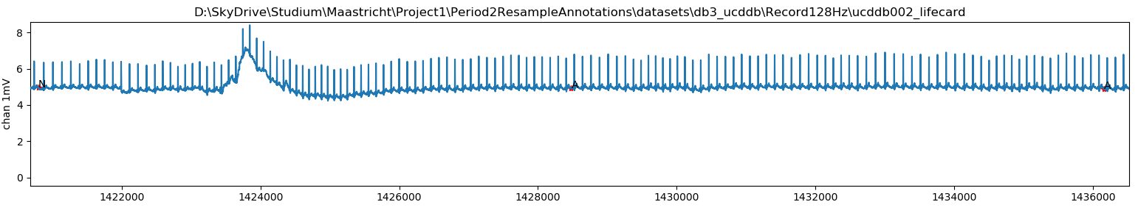
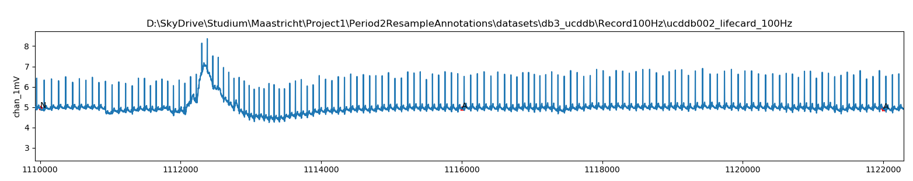

Slide 7
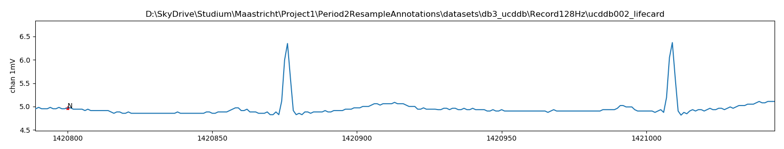
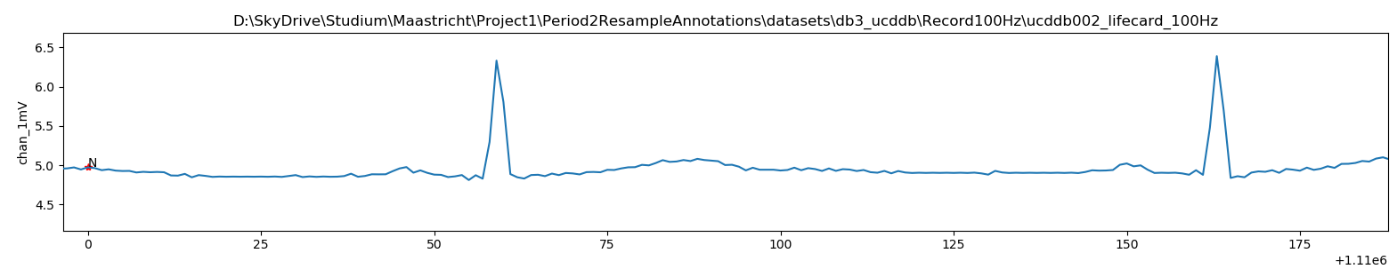

Slide 8
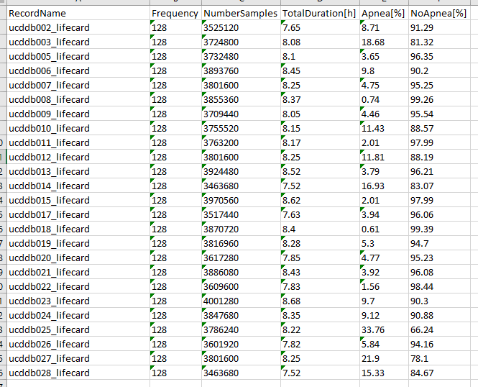
Database 3: 128Hz - all data sets info

Slide 9
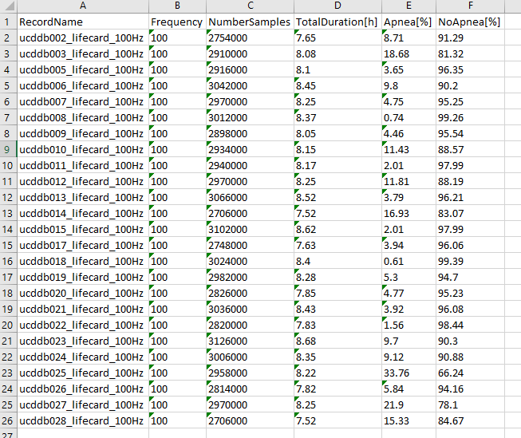
Database 3: 100Hz - all data sets info

